Slide 2
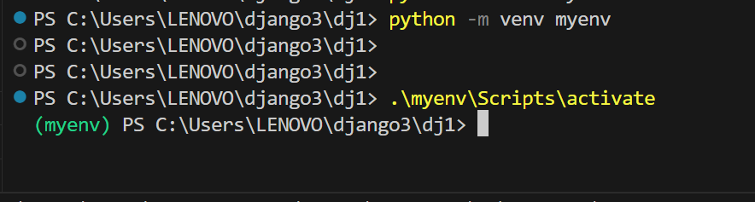

Slide 3
pip install Django
django-admin startproject zappit
cd zappit
ls
python3 manage.py startapp posts

Slide 4
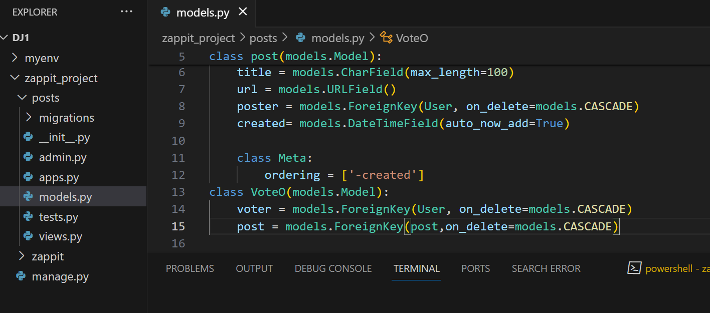
Inside posts

Slide 5
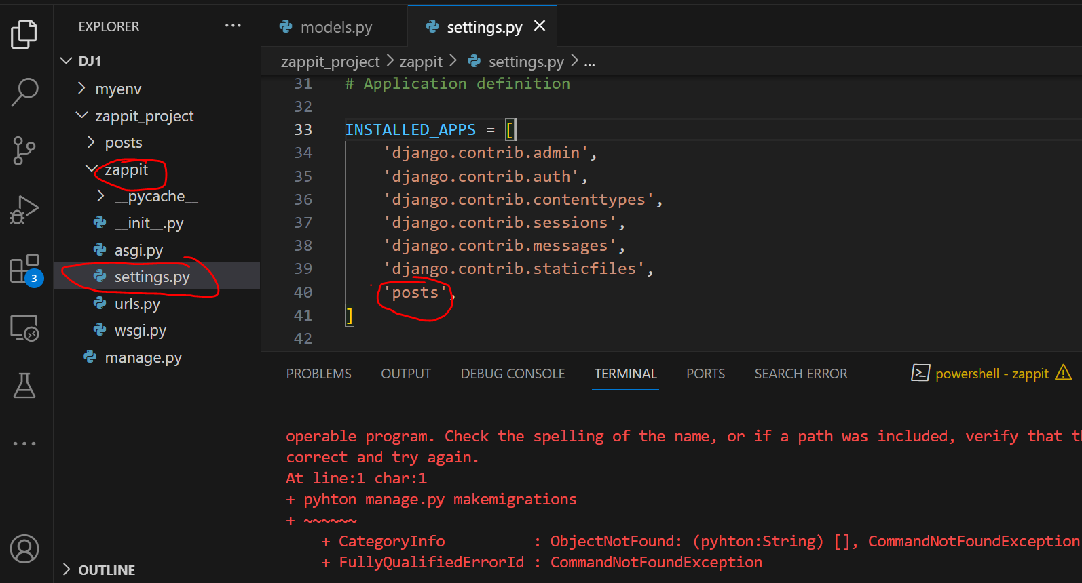
Add posts in installed app in settings in zappit folder

Slide 6
python3 manage.py makemigrations --verbosity 3
python3 manage.py migrate

Slide 7
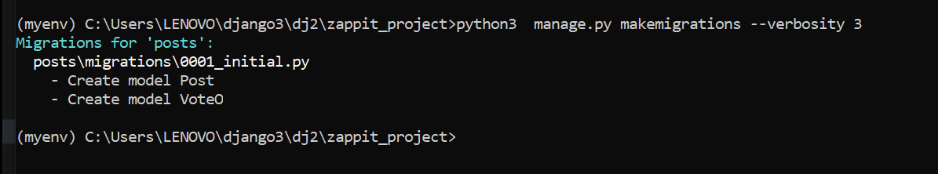

Slide 8
Check installed packages
pip list
pip show djangorestframework

Slide 9
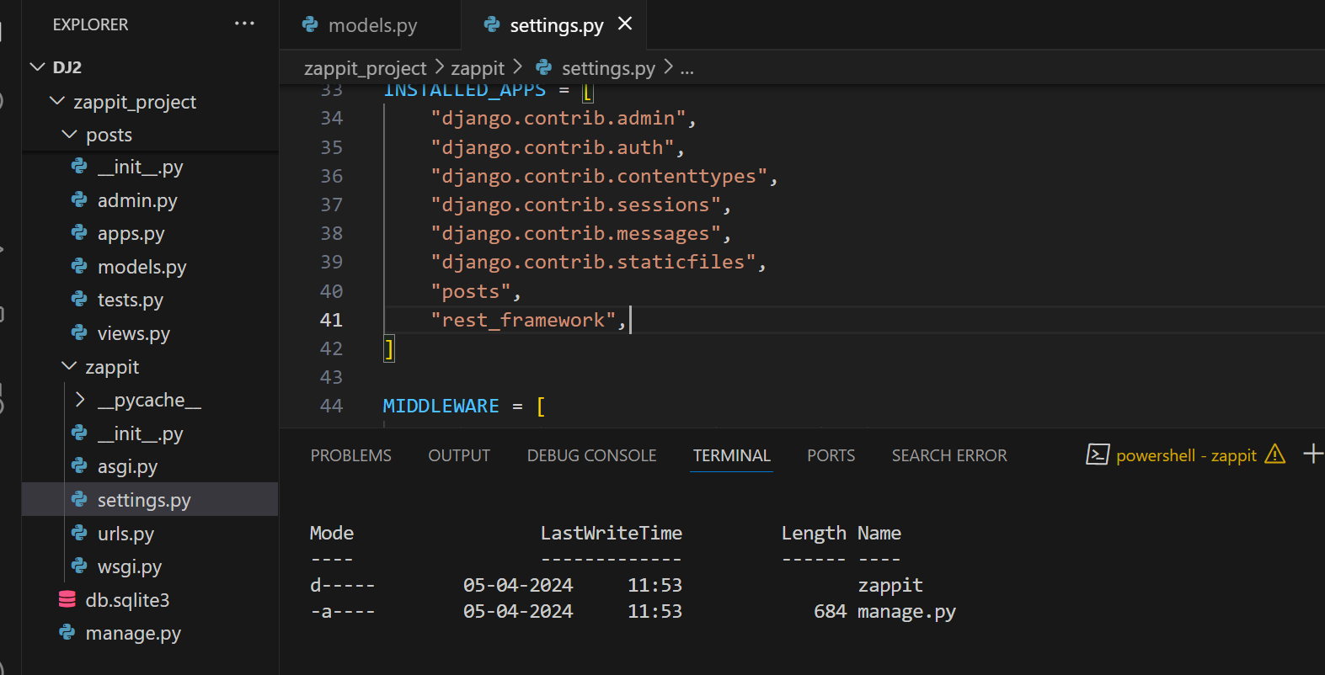
Serializers

Slide 10
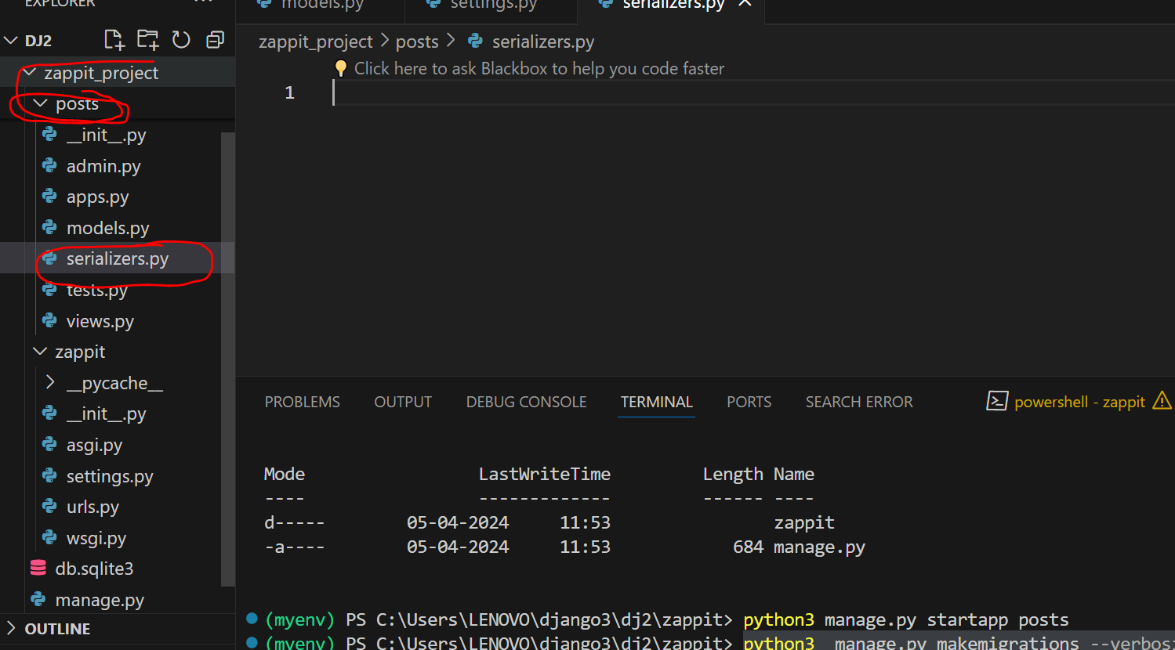
New file in posts called serializers

Slide 11
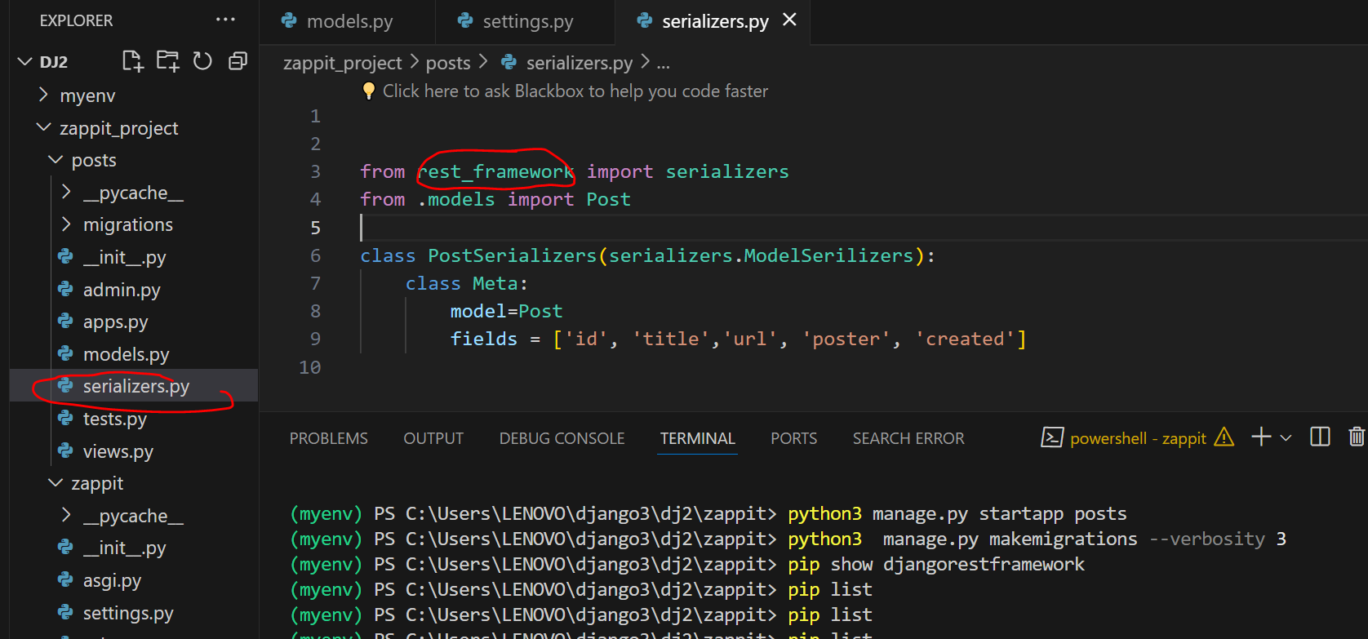

Slide 12
code
from rest_framework import serializers
from .models import Post
class PostSerializers(serializers.ModelSerilizers):
class Meta:
model=Post
fields = ['id', 'title','url', 'poster', 'created']

Slide 13
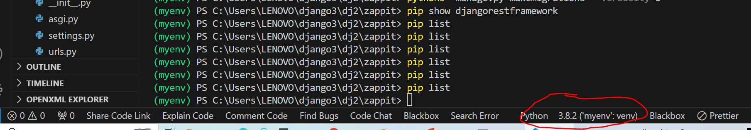
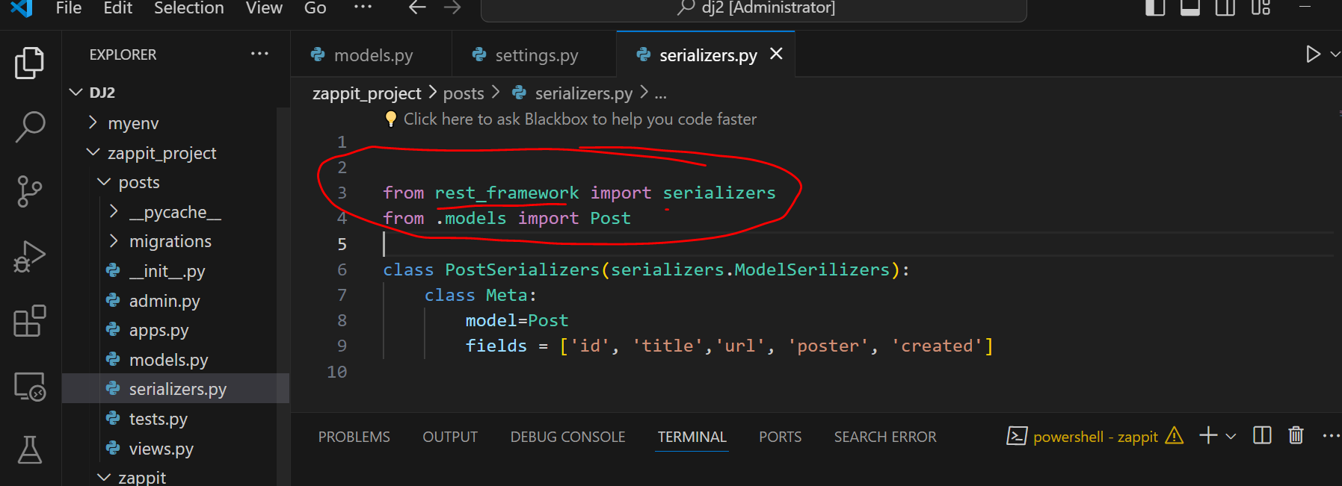
Use correct interpreter otherwise libraries will show wrong values

Slide 14
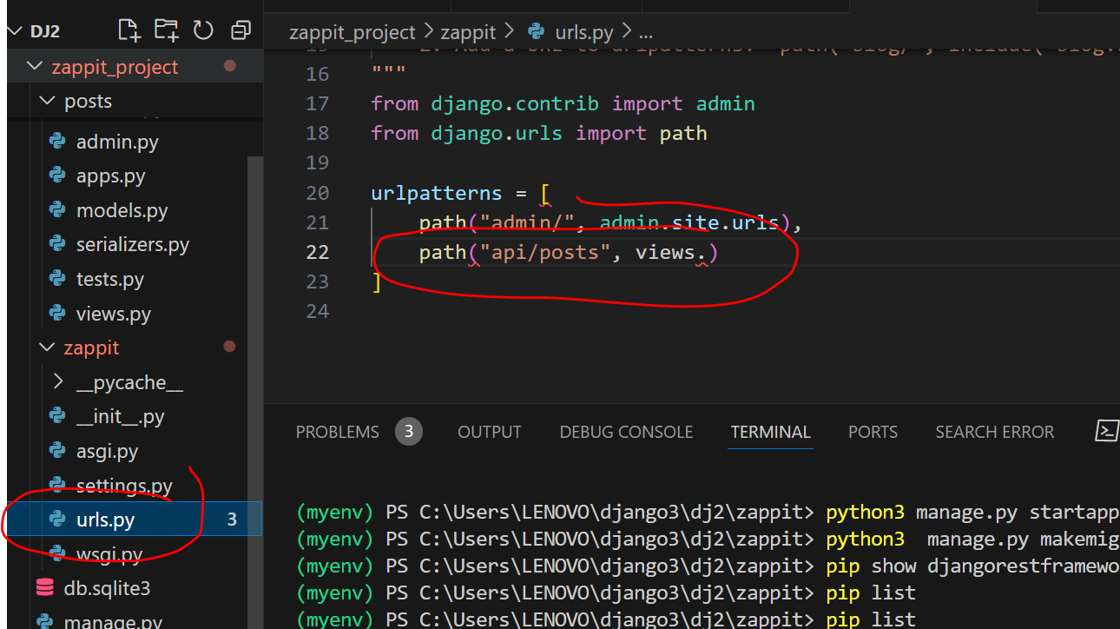
To create url it must be connected to views in posts folder lets got to post folder

Slide 15
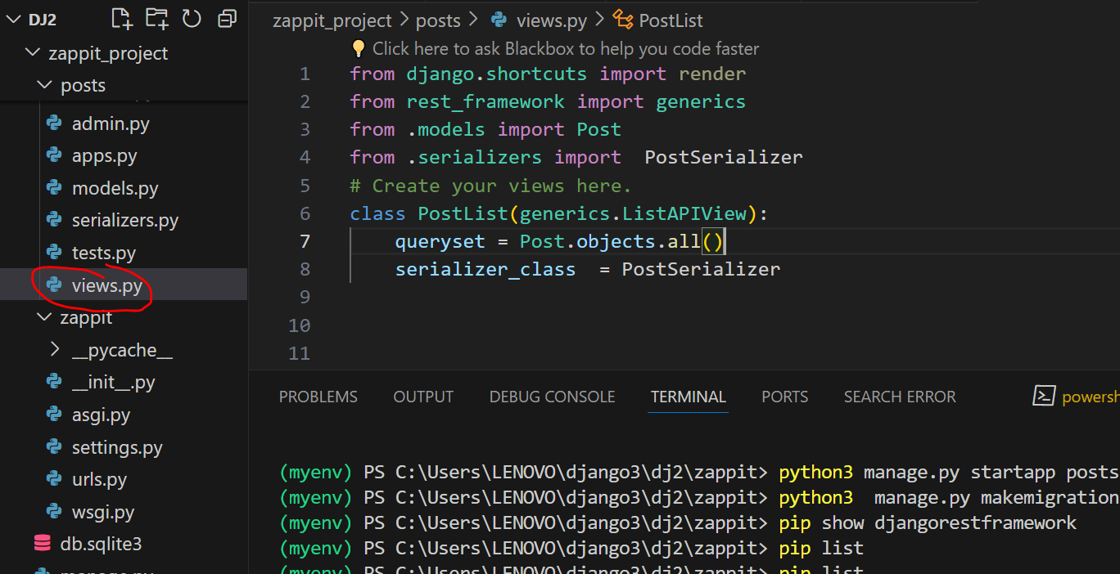

Slide 16
code
from django.shortcuts import render
from rest_framework import generics
from .models import Post
from .serializers import PostSerializer
# Create your views here.
class PostList(generics.ListAPIView):
queryset = Post.objects.all()
serializer_class = PostSerializer

Slide 17
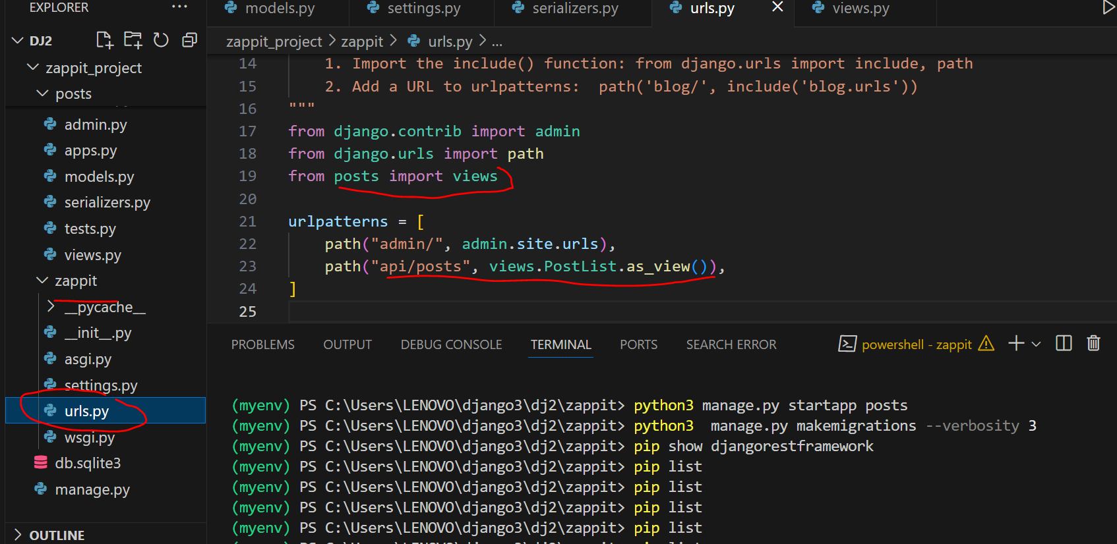

Slide 18
code
from django.contrib import admin
from django.urls import path
from posts import views
urlpatterns = [
path("admin/", admin.site.urls),
path("api/posts", views.PostList.as_view()),
]

Slide 19
python manage.py runserver
Or
python3 manage.py runserver
http://127.0.0.1:8000/api/posts

Slide 20
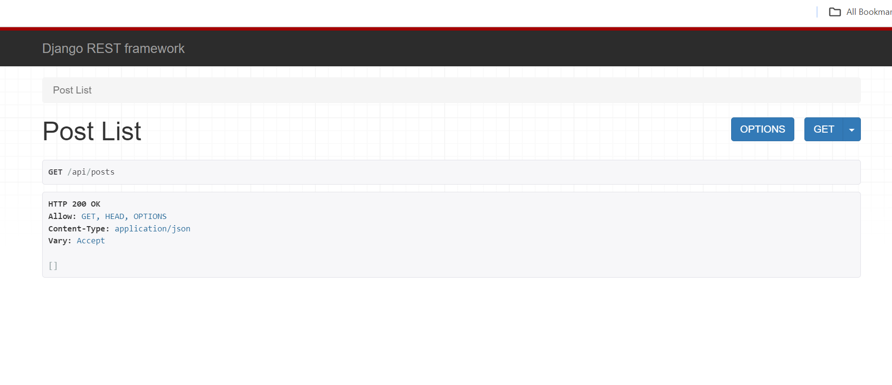

Slide 21
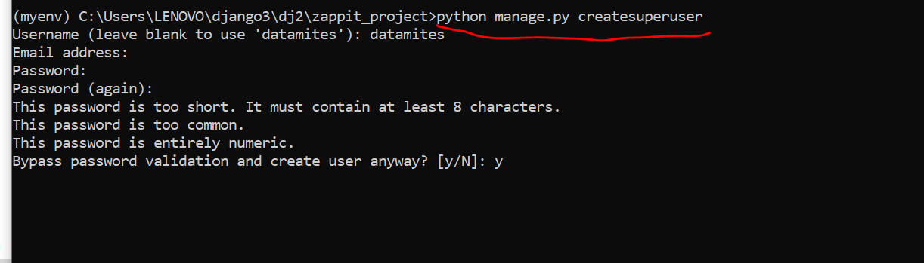
Username:datamites
Leave email id blank
Password : 1234

Slide 22
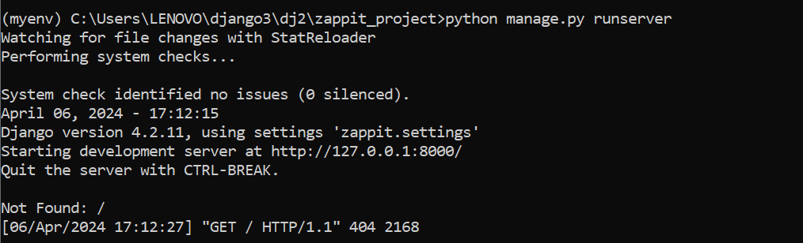
Run server again

Slide 23
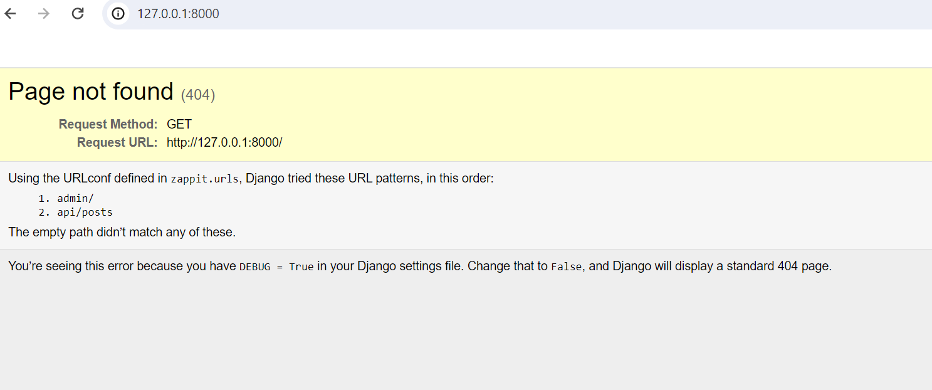
Paste url

Slide 24
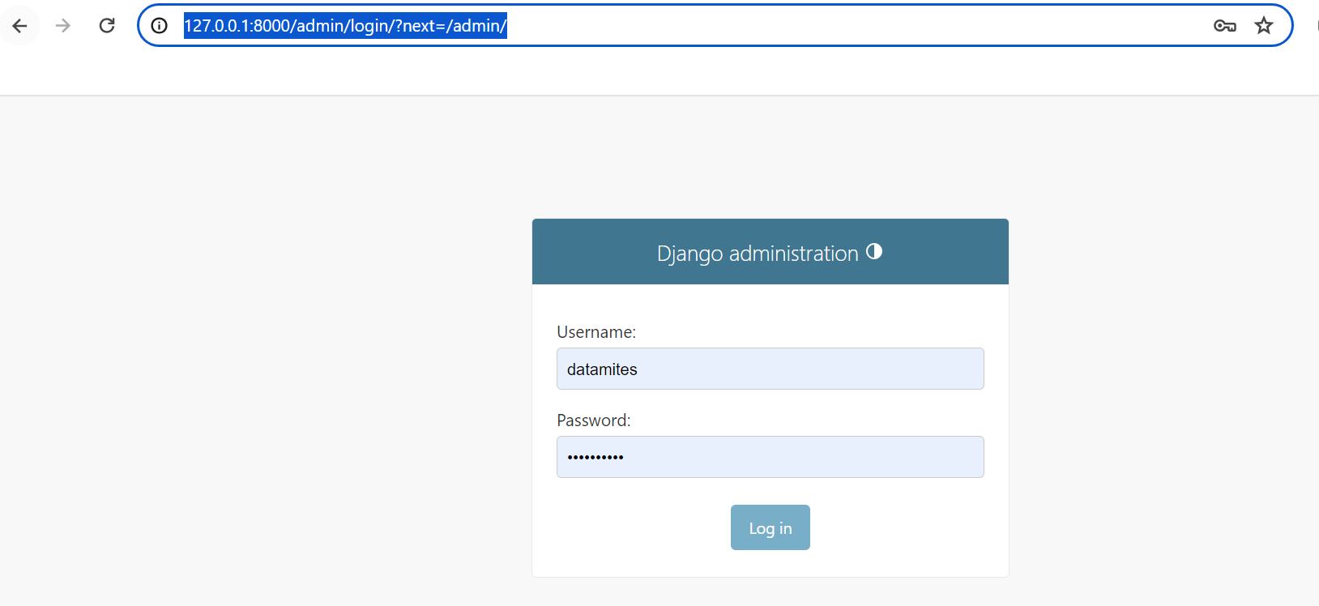
http://127.0.0.1:8000/admin

Slide 25
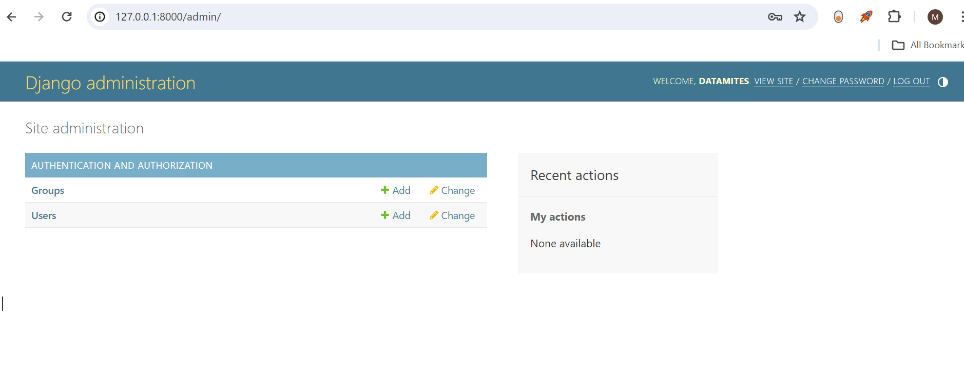

Slide 26
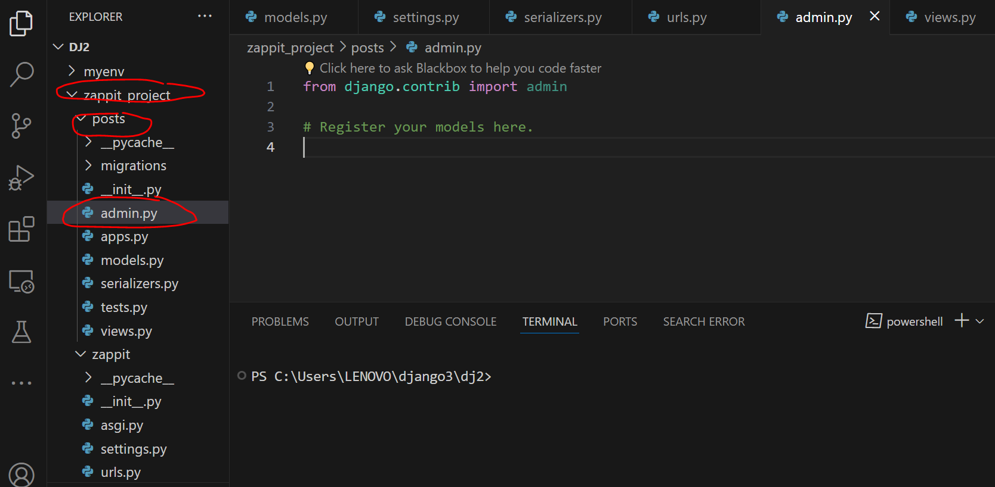
Go to admin in posts

Slide 27
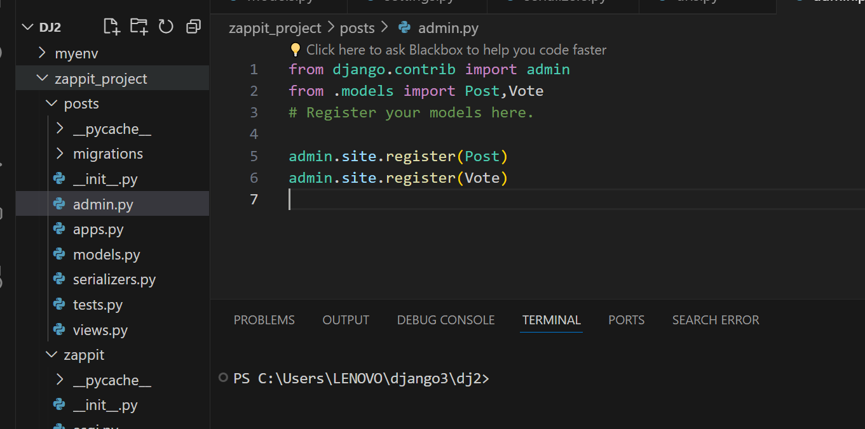

Slide 28
from django.contrib import admin
from .models import Post,Vote
# Register your models here.
admin.site.register(Post)
admin.site.register(Vote)

Slide 29
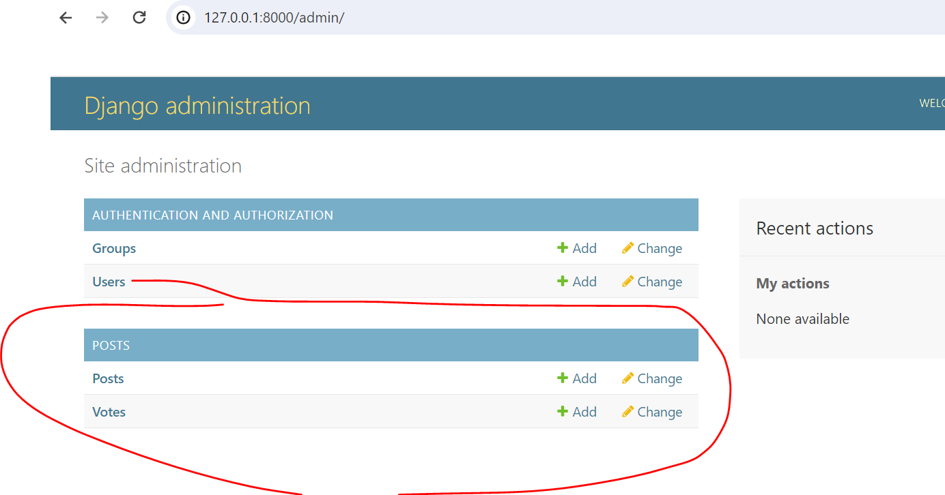

Slide 30
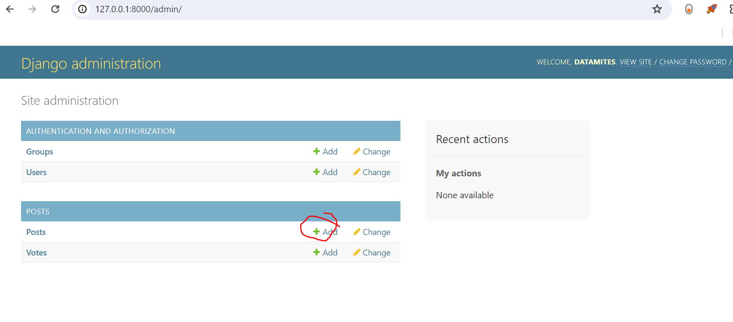
Add post

Slide 31
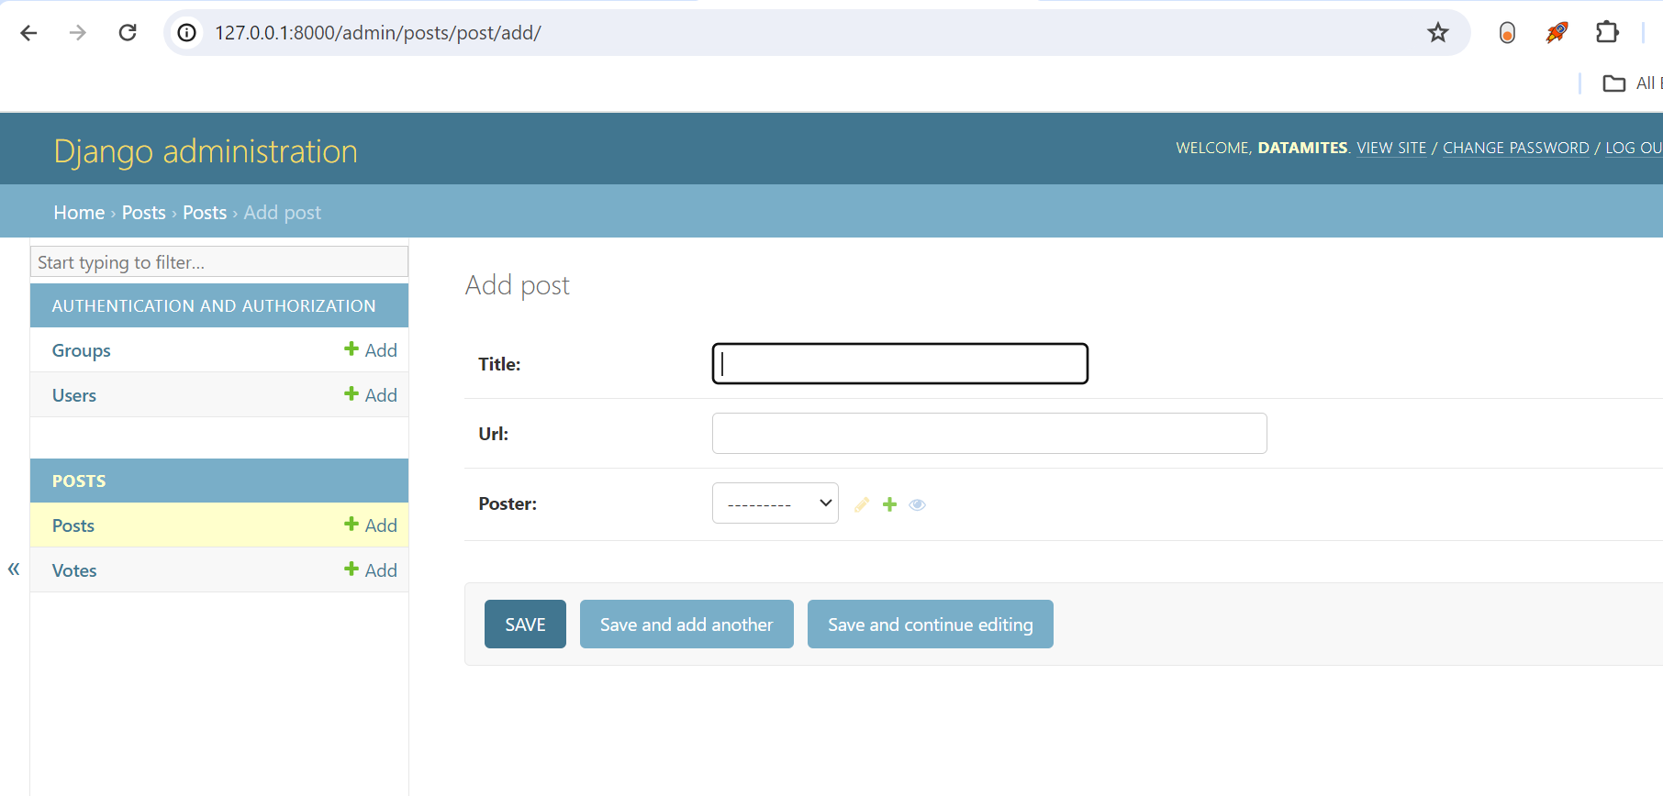

Slide 32
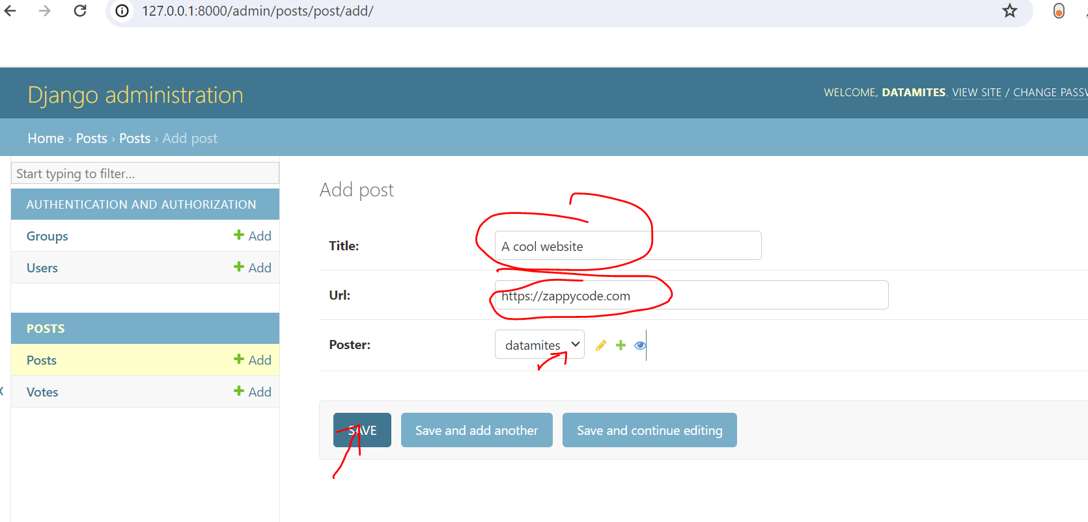
Enter data and save

Slide 33
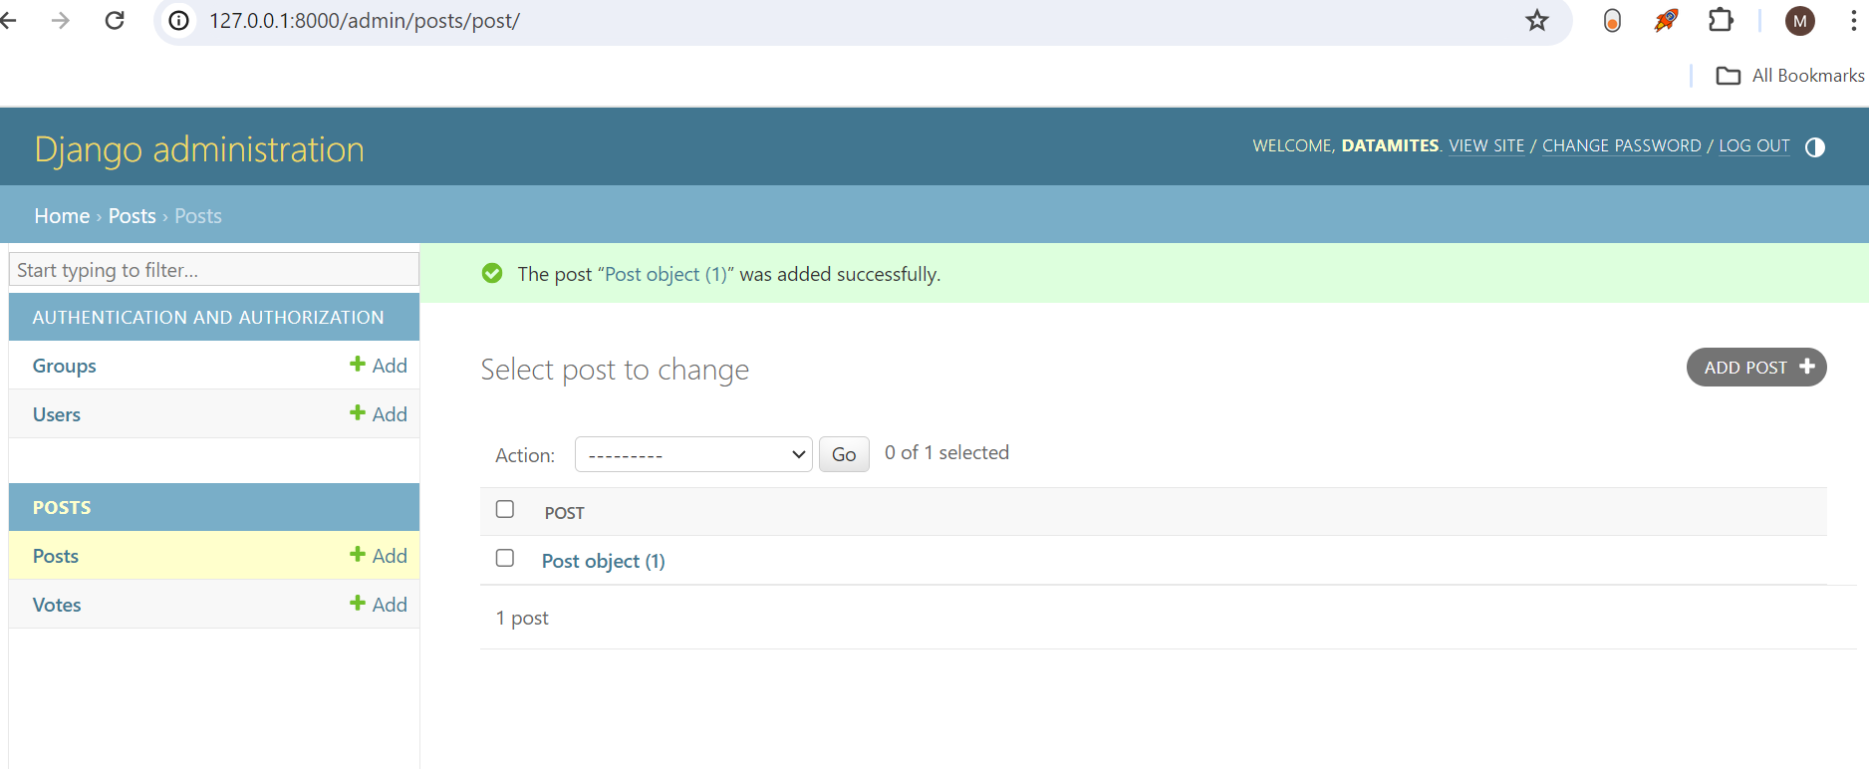

Slide 34
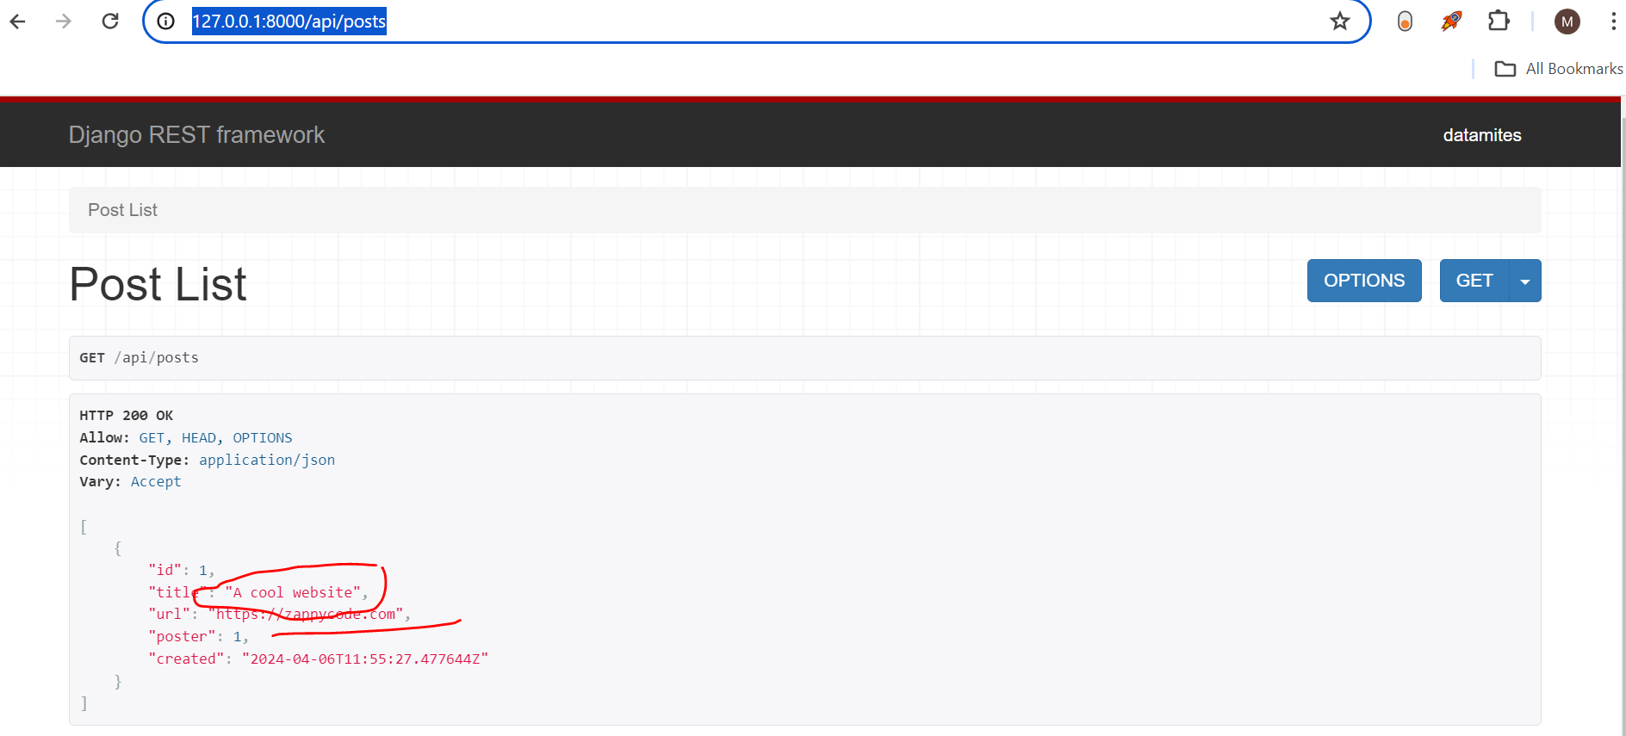
Go to
http://127.0.0.1:8000/api/posts
Api is running

Slide 35
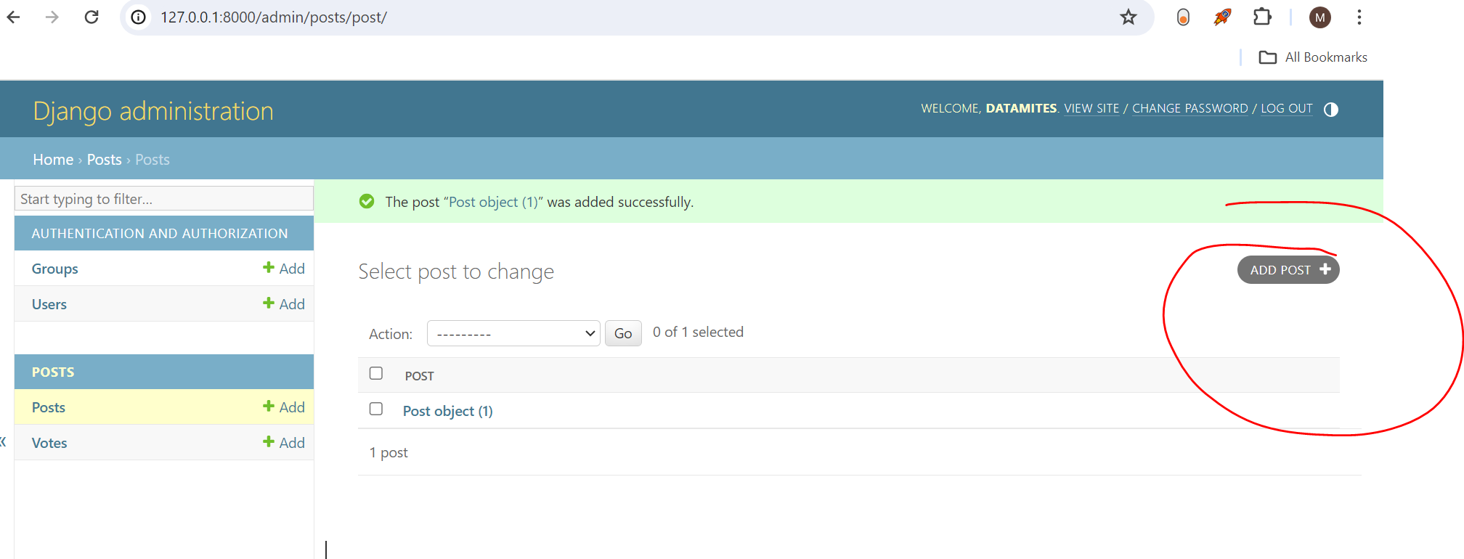
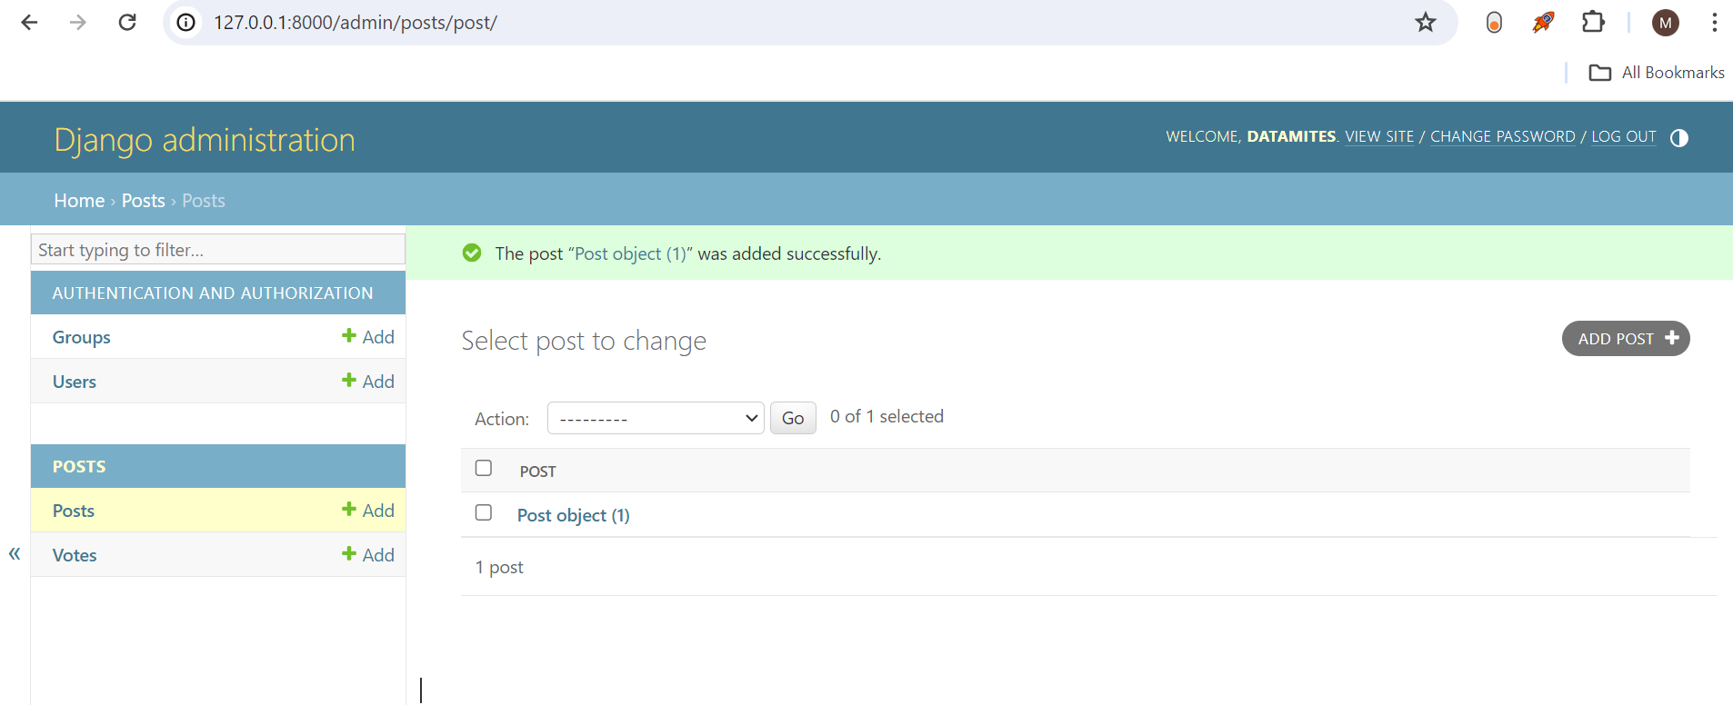
Lets create a new post

Slide 36
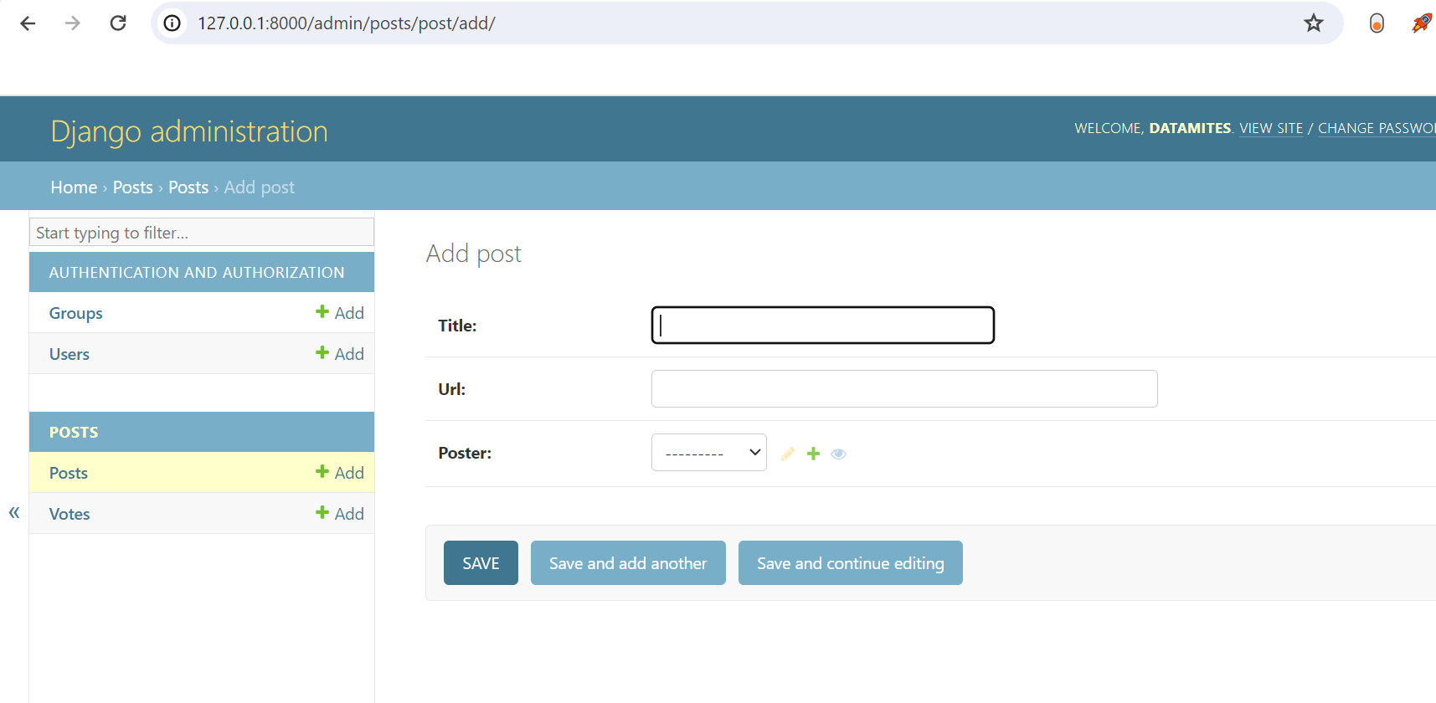

Slide 37
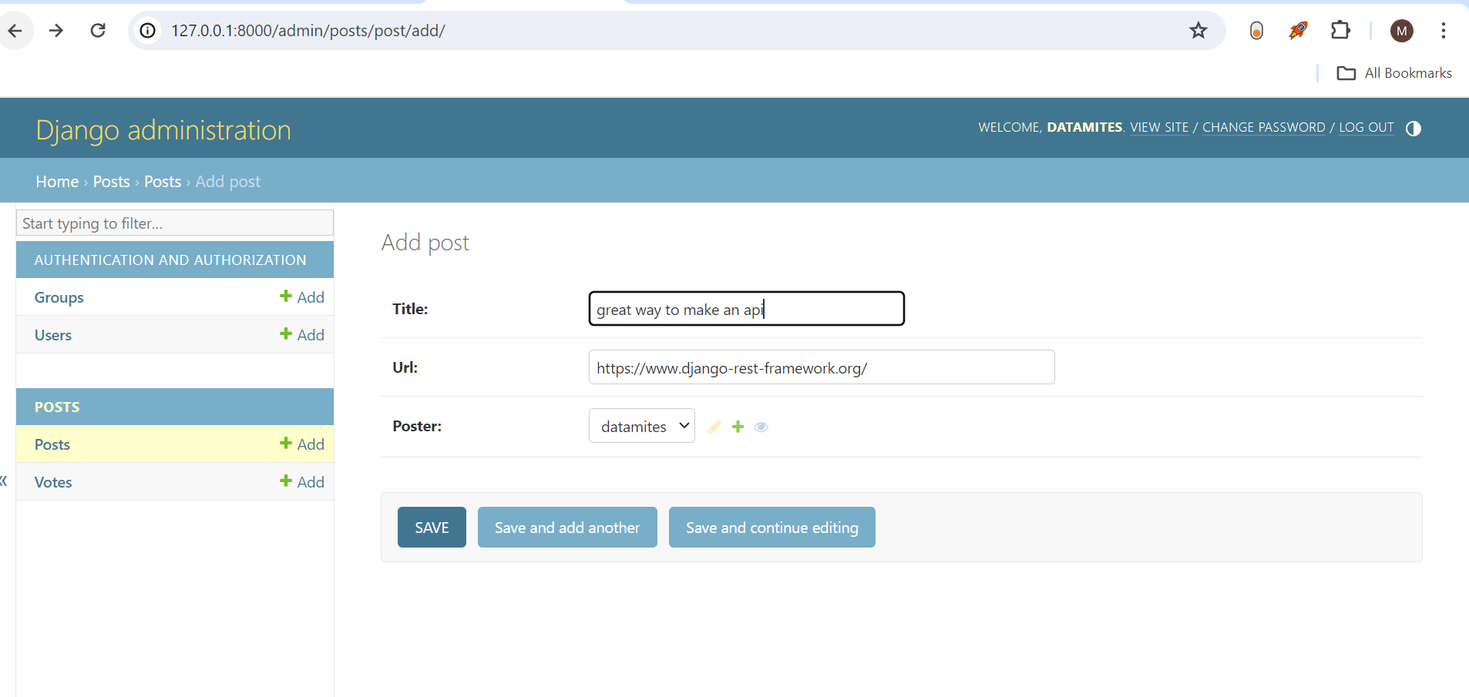
Save

Slide 38
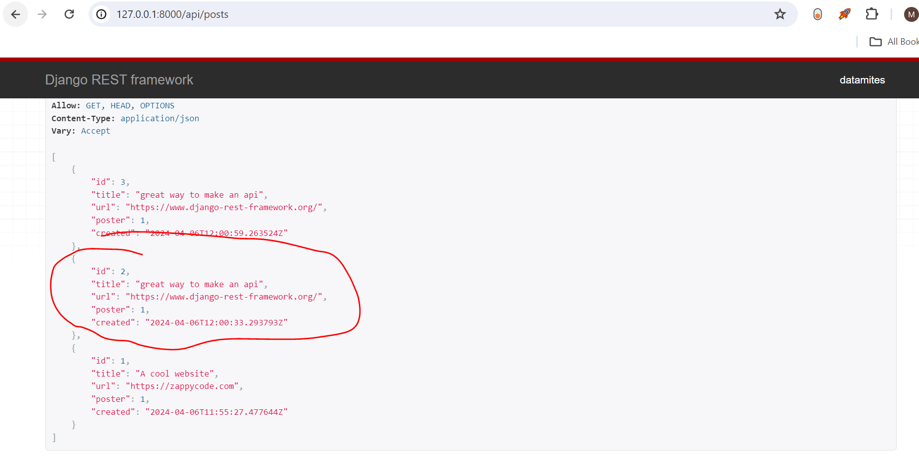
Saved twice here

Slide 39
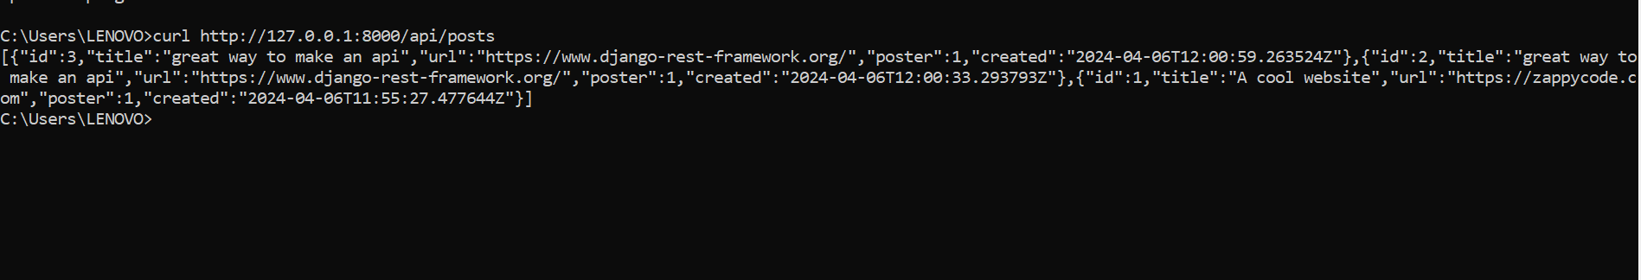
How to run it using cmd
curl http://127.0.0.1:8000/api/posts
Or
Invoke-WebRequest -Uri http://127.0.0.1:8000/api/posts

Slide 40
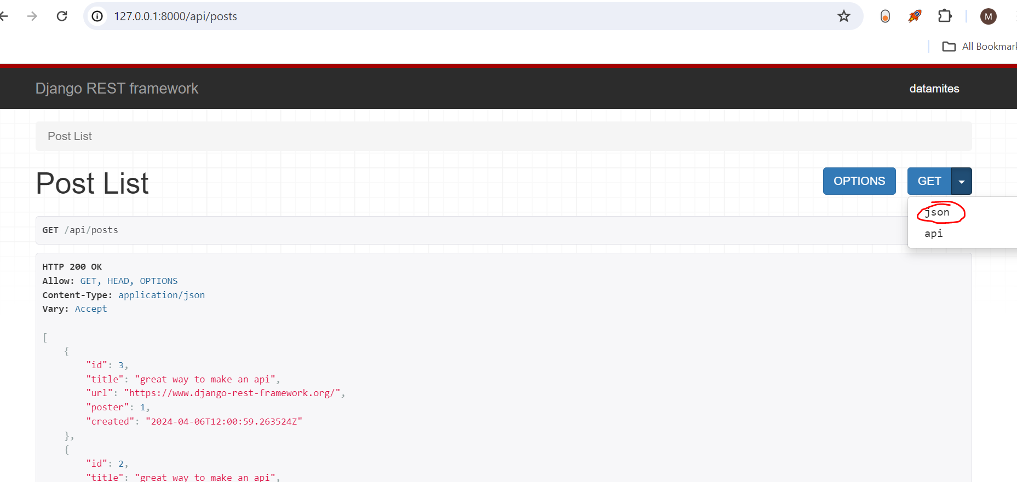
To show in json format

Slide 41
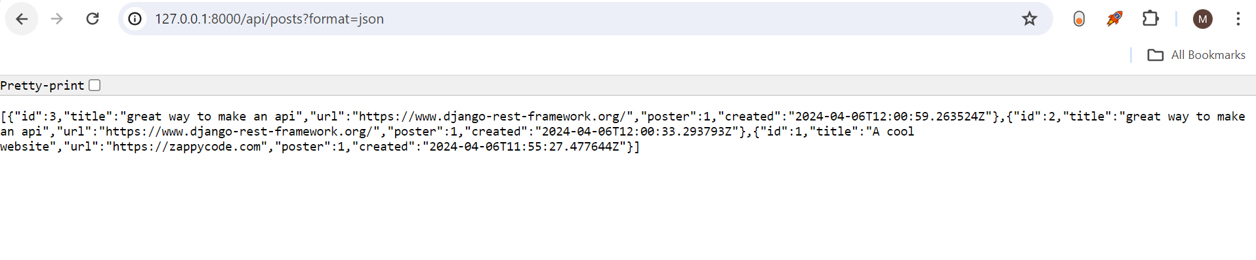
json

Slide 42
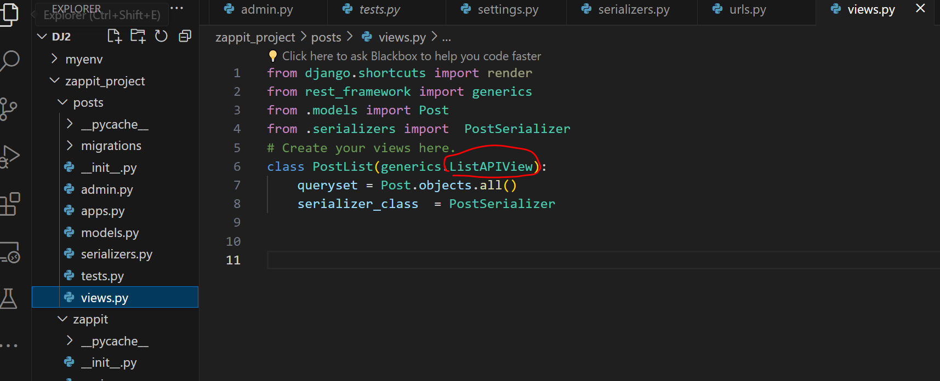
Creating POSTS

Slide 43
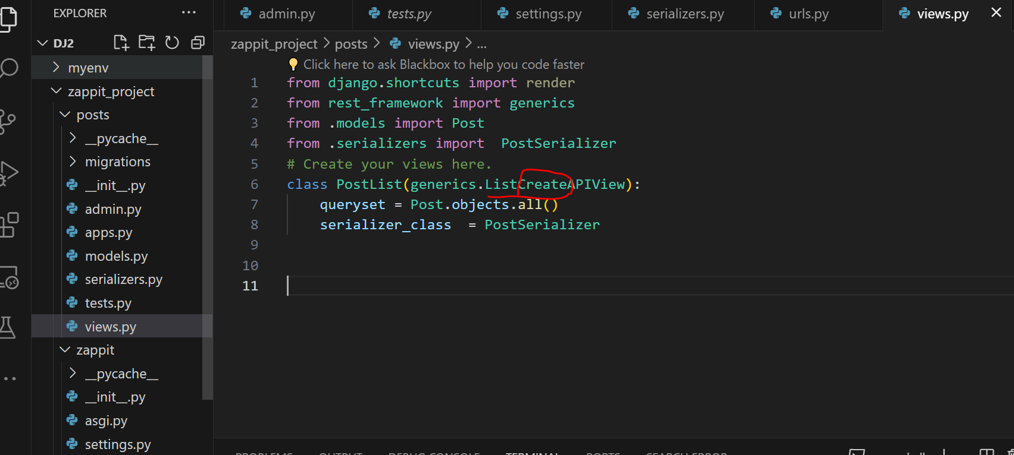
Add create there

Slide 44
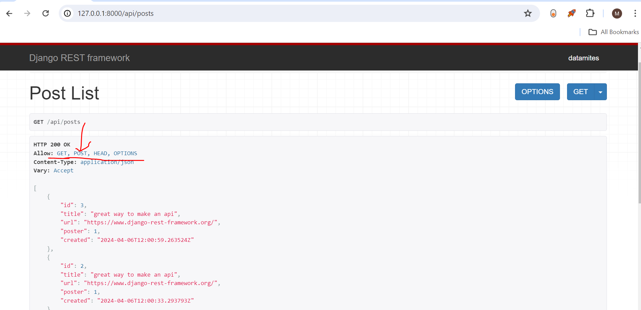
Reload page, we can post now

Slide 45
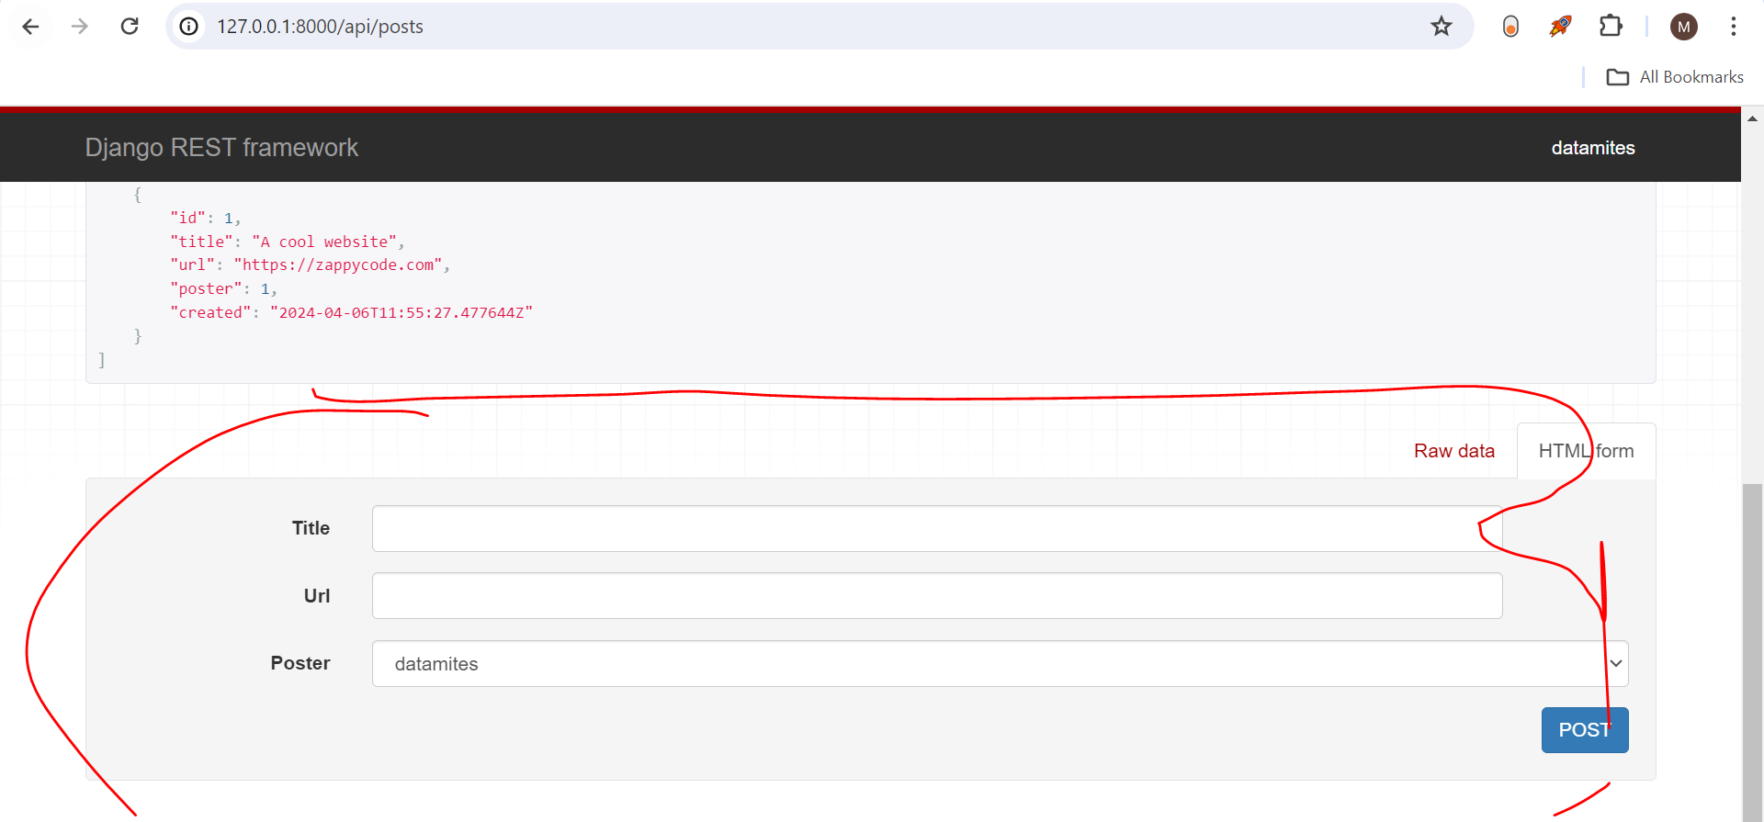
Can post

Slide 46
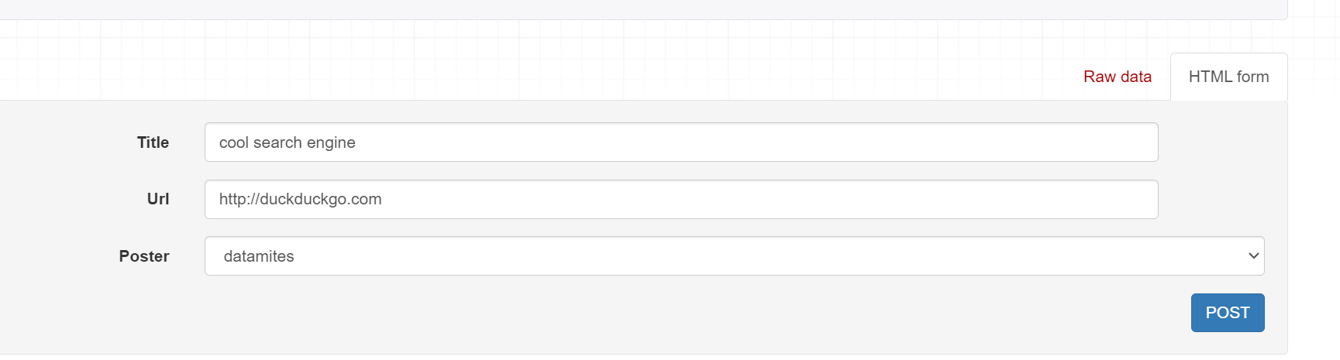

Slide 47
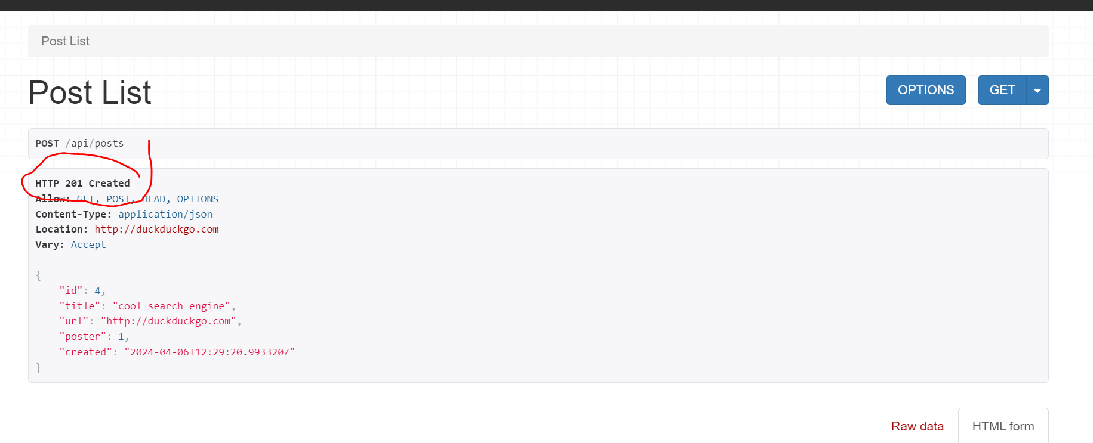

Slide 48
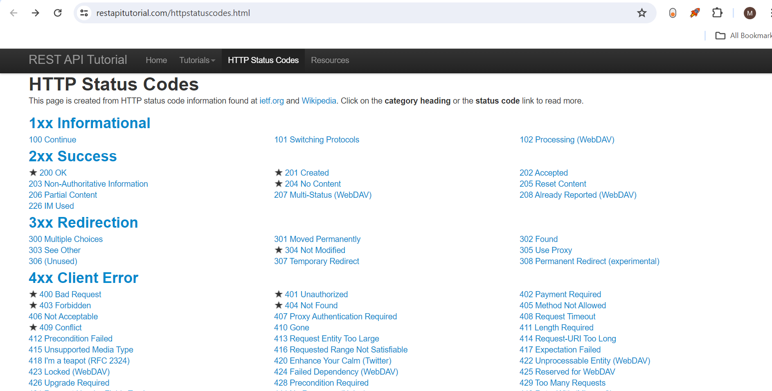

Slide 49
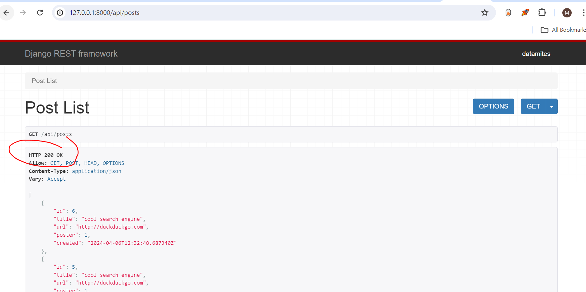

Slide 50
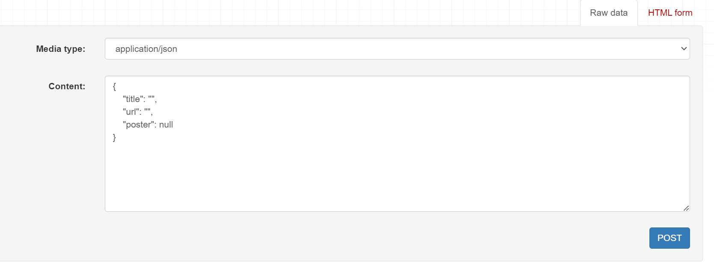

Slide 51
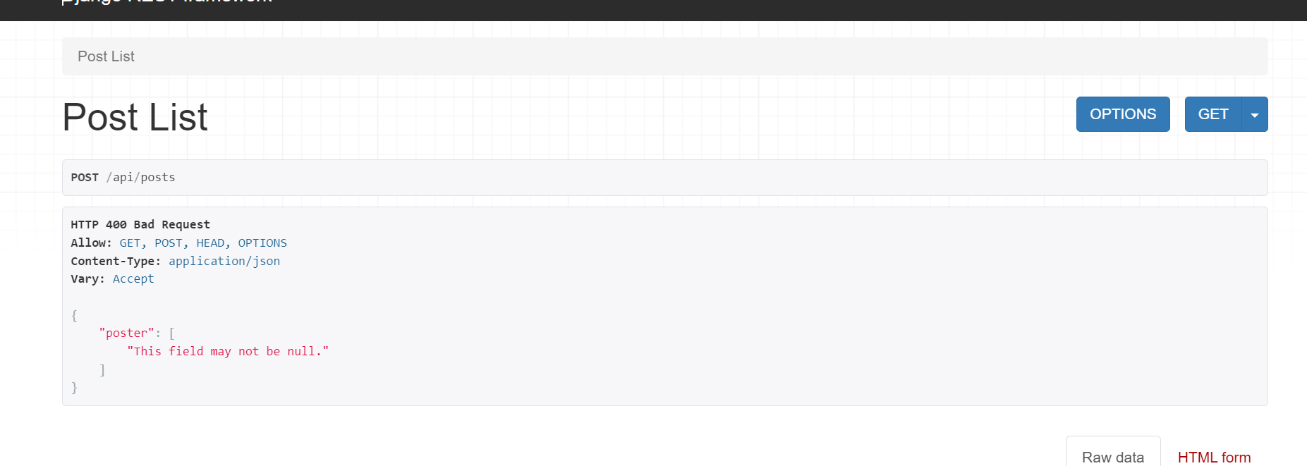

Slide 52
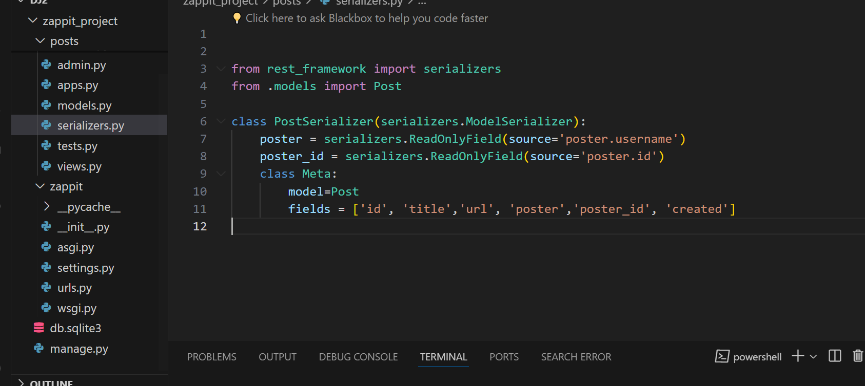
Add two lines

Slide 53
from rest_framework import serializers
from .models import Post
class PostSerializer(serializers.ModelSerializer):
poster = serializers.ReadOnlyField(source='poster.username')
poster_id = serializers.ReadOnlyField(source='poster.id')
class Meta:
model=Post
fields = ['id', 'title','url', 'poster','poster_id', 'created']

Slide 54
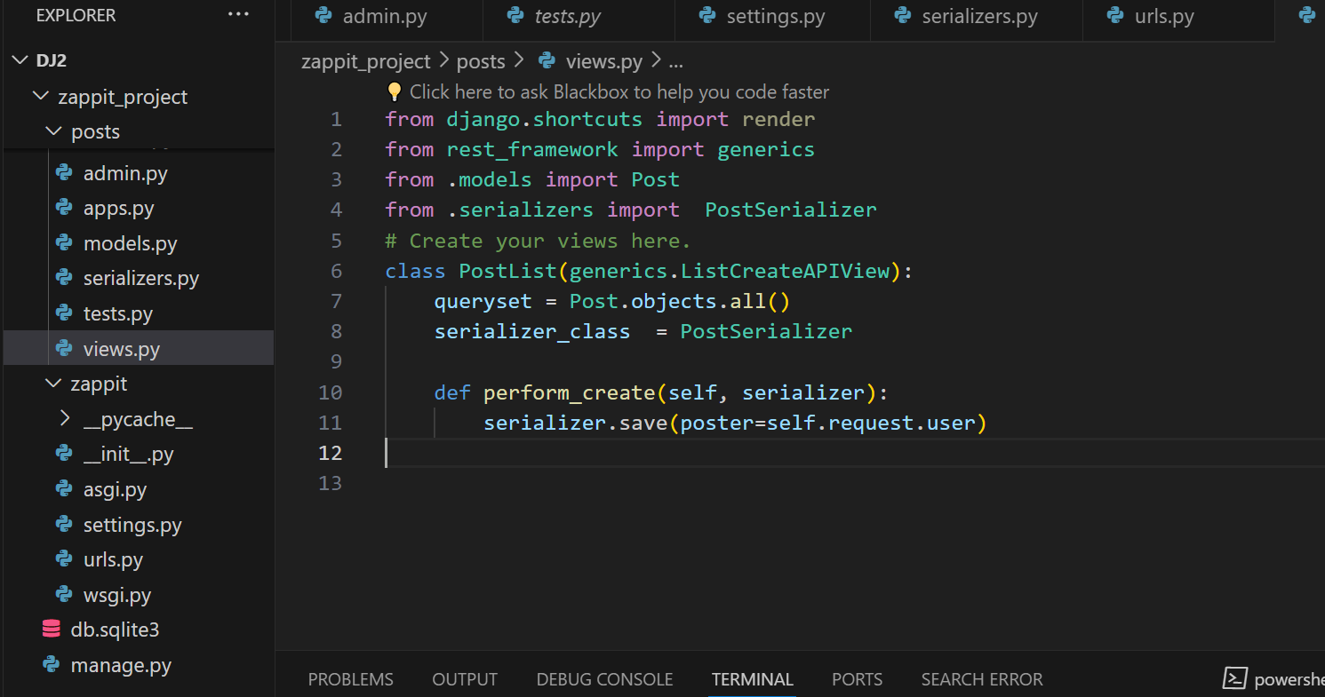

Slide 55
from django.shortcuts import render
from rest_framework import generics,permissions
from .models import Post
from .serializers import PostSerializer
# Create your views here.
class PostList(generics.ListCreateAPIView):
queryset = Post.objects.all()
serializer_class = PostSerializer
permission_classes=[permissions.IsAuthenticatedOrReadOnly ]
def perform_create(self, serializer):
serializer.save(poster=self.request.user)

Slide 56
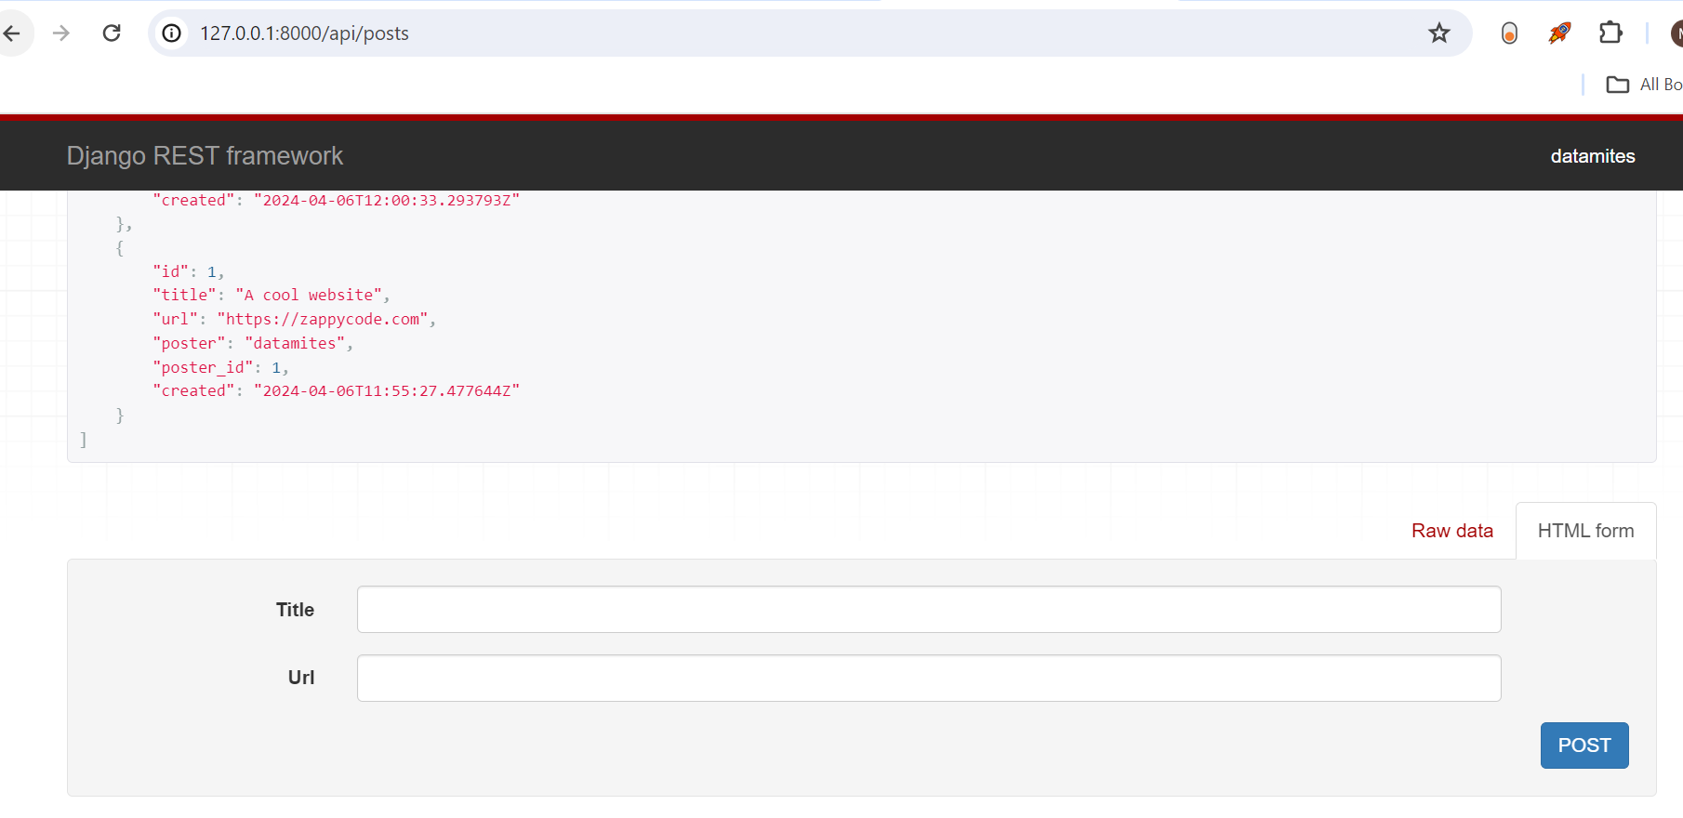
Reload page

Slide 57
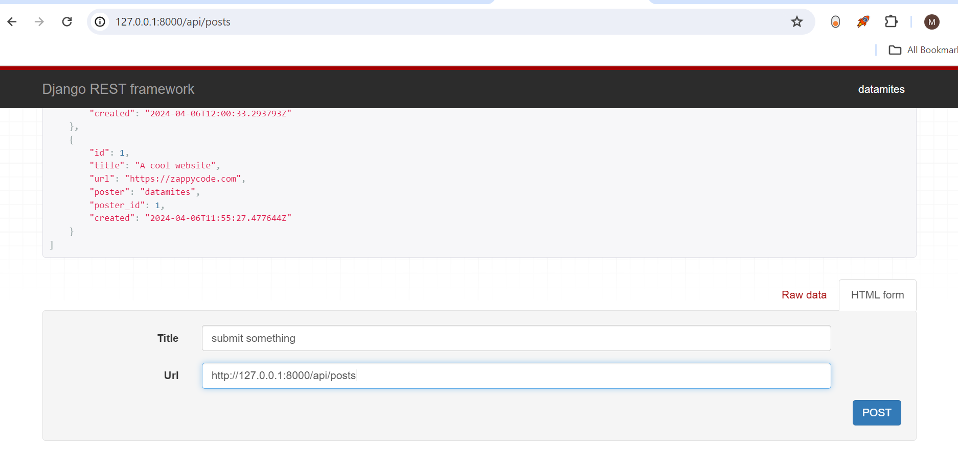

Slide 58
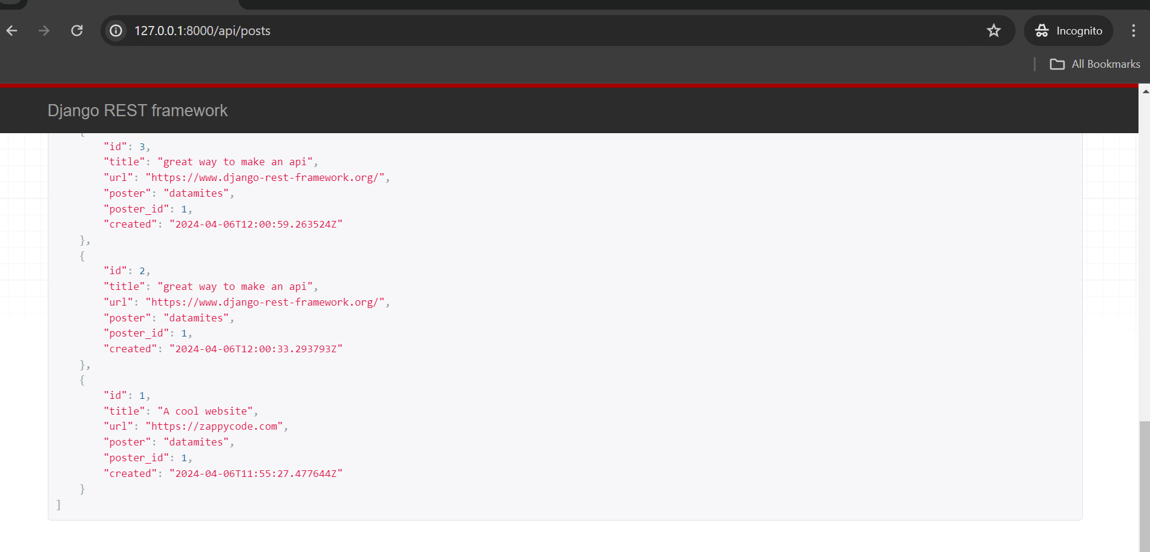
Without login as datamites cannot post only view

Slide 59
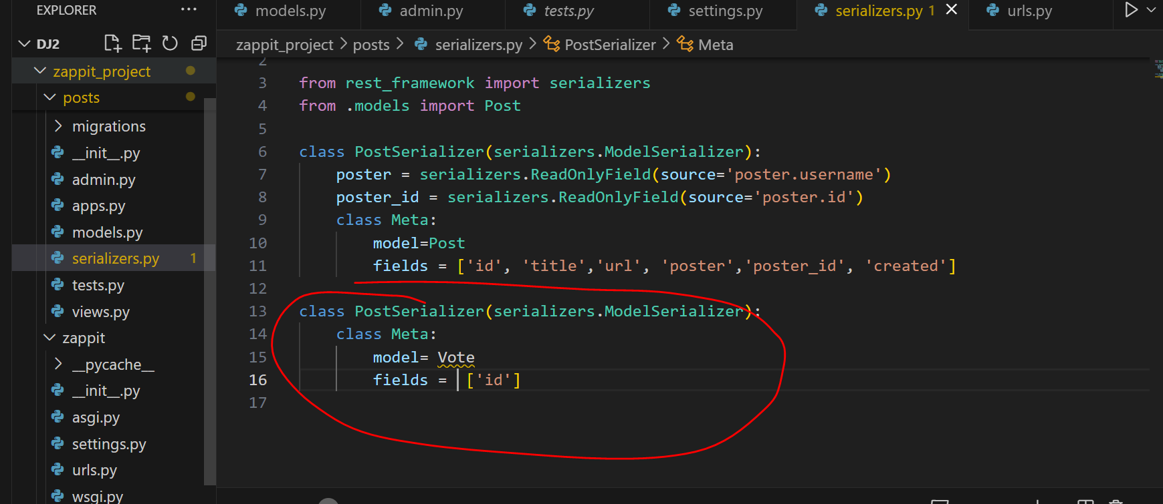
How to upvote ?

Slide 60
from rest_framework import serializers
from .models import Post
class PostSerializer(serializers.ModelSerializer):
poster = serializers.ReadOnlyField(source='poster.username')
poster_id = serializers.ReadOnlyField(source='poster.id')
class Meta:
model=Post
fields = ['id', 'title','url', 'poster','poster_id', 'created']
class PostSerializer(serializers.ModelSerializer):
class Meta:
model= Vote
fields = ['id']

Slide 61


Slide 62
from rest_framework import serializers
from .models import Post
class PostSerializer(serializers.ModelSerializer):
poster = serializers.ReadOnlyField(source='poster.username')
poster_id = serializers.ReadOnlyField(source='poster.id')
class Meta:
model=Post
fields = ['id', 'title','url', 'poster','poster_id', 'created']
class PostSerializer(serializers.ModelSerializer):
class Meta:
model= Vote
fields = ['id']

Slide 63


Slide 64
from django.shortcuts import render
from rest_framework import generics,permissions
from .models import Post ,Vote
from .serializers import PostSerializer , VoteSerializer
# Create your views here.
class PostList(generics.ListCreateAPIView):
queryset = Post.objects.all()
serializer_class = PostSerializer
permission_classes=[permissions.IsAuthenticatedOrReadOnly ]
def perform_create(self, serializer):
serializer.save(poster=self.request.user)
class VoteCreate(generics.CreateAPIView):
serializer_class = VoteSerializer
permission_classes=[permissions.IsAuthenticated]
def get_queryset(self):
user = self.request.user
post = Post.objects.get(pk= self.kwargs['pk'])
return Vote.object.filter(voter=user, post=post)

Slide 65


Slide 66
"""
URL configuration for zappit project.
The `urlpatterns` list routes URLs to views. For more information please see:
https://docs.djangoproject.com/en/4.2/topics/http/urls/
Examples:
Function views
1. Add an import: from my_app import views
2. Add a URL to urlpatterns: path('', views.home, name='home')
Class-based views
1. Add an import: from other_app.views import Home
2. Add a URL to urlpatterns: path('', Home.as_view(), name='home')
Including another URLconf
1. Import the include() function: from django.urls import include, path
2. Add a URL to urlpatterns: path('blog/', include('blog.urls'))
"""
from django.contrib import admin
from django.urls import path
from posts import views
urlpatterns = [
path("admin/", admin.site.urls),
path("api/posts", views.PostList.as_view()),
path("api/posts/<int:pk>/vote", views.VoteCreate.as_view())
]

Slide 67


Slide 68
from rest_framework import serializers
from .models import Post,Vote
class PostSerializer(serializers.ModelSerializer):
poster = serializers.ReadOnlyField(source='poster.username')
poster_id = serializers.ReadOnlyField(source='poster.id')
class Meta:
model=Post
fields = ['id', 'title','url', 'poster','poster_id', 'created']
class PostSerializer(serializers.ModelSerializer):
class Meta:
model= Vote
fields = ['id']

Slide 69
Views.py
from django.shortcuts import render
from rest_framework import generics,permissions
from .models import Post ,Vote
from .serializers import PostSerializer ,VoteSerializer
# Create your views here.
class PostList(generics.ListCreateAPIView):
queryset = Post.objects.all()
serializer_class = PostSerializer
permission_classes=[permissions.IsAuthenticatedOrReadOnly ]
def perform_create(self, serializer):
serializer.save(poster=self.request.user)
class VoteCreate(generics.CreateAPIView):
serializer_class = VoteSerializer
permission_classes=[permissions.IsAuthenticated]
def get_queryset(self):
user = self.request.user
post = Post.objects.get(pk= self.kwargs['pk'])
return Vote.object.filter(voter=user, post=post)
def perform_create(self, serializer):
serializer.save(voter=self.request.user,post=Post.objects.get(pk= self.kwargs['pk']))

Slide 70
Urls.py
"""
URL configuration for zappit project.
The `urlpatterns` list routes URLs to views. For more information please see:
https://docs.djangoproject.com/en/4.2/topics/http/urls/
Examples:
Function views
1. Add an import: from my_app import views
2. Add a URL to urlpatterns: path('', views.home, name='home')
Class-based views
1. Add an import: from other_app.views import Home
2. Add a URL to urlpatterns: path('', Home.as_view(), name='home')
Including another URLconf
1. Import the include() function: from django.urls import include, path
2. Add a URL to urlpatterns: path('blog/', include('blog.urls'))
"""
from django.contrib import admin
from django.urls import path
from posts import views
urlpatterns = [
path("admin/", admin.site.urls),
path("api/posts", views.PostList.as_view()),
path("api/posts/<int:pk>/vote", views.VoteCreate.as_view())
]

Slide 71
Serializers.py
from rest_framework import serializers
from .models import Post,Vote
class PostSerializer(serializers.ModelSerializer):
poster = serializers.ReadOnlyField(source='poster.username')
poster_id = serializers.ReadOnlyField(source='poster.id')
class Meta:
model=Post
fields = ['id', 'title','url', 'poster','poster_id', 'created']
class VoteSerializer(serializers.ModelSerializer):
class Meta:
model= Vote
fields = ['id']

Slide 72


